Slide 1

ArrayTrack: A Fine-Grained Indoor Location System
Jie Xiong, Kyle Jamieson
University College London
April 3rd, 2013
USENIX NSDI ‘13

Slide 2

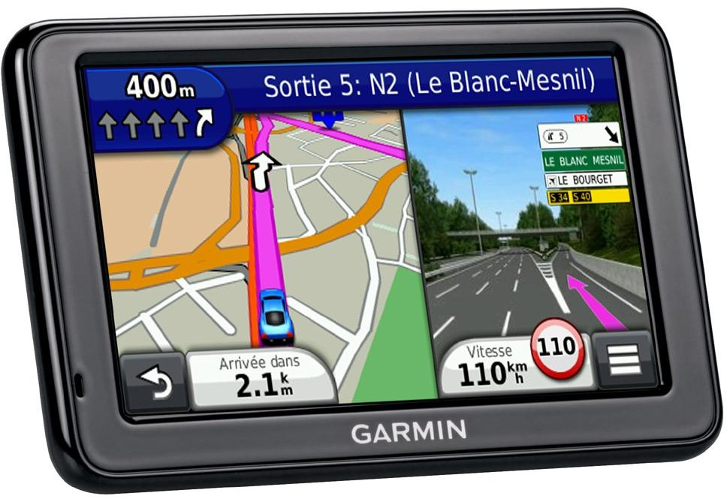
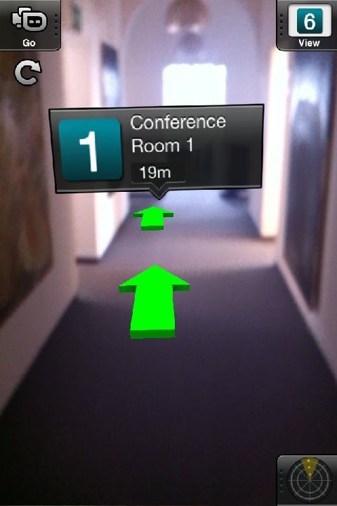
Precise location systems are important
Outdoors: GPS
  Accurate for navigation (meters)
  Signals fade in indoor environments
Precise and rapid indoor location enables:
Augmented reality on the smartphone, wearable or glasses
Fine-grained location in supermarkets, libraries or museums
Controlling network access based on desk or room
Known technologies: not accurate enough (WiFi), require dedicated infrastructure (ultrasound) or require cameras and good light conditions (vision)
2

Slide 3
Timeline of indoor location systems
3 cm (Bat) Ward et al
2-3 m (RADAR)
Bahl et al
39-51cm (Horus) Youssef et al
1 m (PinLoc) Sen et al
2 m (EZ)
Chintalapudi et al
23 cm (ArrayTrack)
1992
2004
2008
2012
1997
2000
2005
2010
2013
time
5-10 cm (Cricket) Priyantha et al
30 cm (image-based) Hile and Boriello
97 cm (PinPoint) Joshi et al
1.2-4 m (Zee)
Rai et al
>1 m (Badge) Want et al
5.4 m (TIX) Gwon et al
3

Slide 4
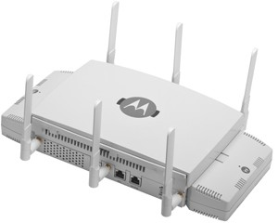
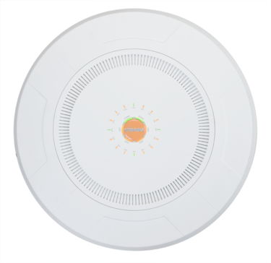
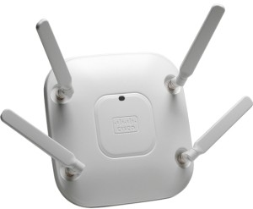
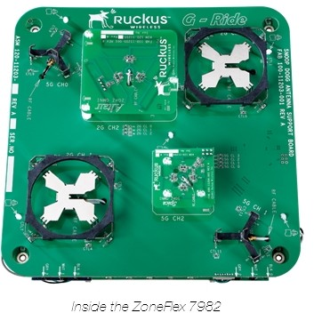
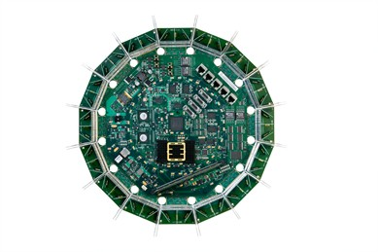
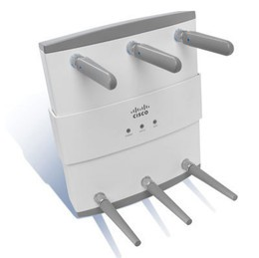
Two observations about WiFi
Increasing number of antennas on an access point (AP)
  802.11n MIMO links: improve capacity and coverage
  Draft 802.11ac (2014): 8 MIMO spatial streams (8 antennas)
4 antennas
6 antennas
14 antennas
16 antennas
Motorola AP8132
Cisco Aironet 3600
Cisco Aironet 1250
RUCKUS ZoneFlex 7982
Xirrus XR7630
4

Slide 5
Two observations about WiFi
Increasing number of antennas on an access point (AP)
  802.11n MIMO links: improve capacity and coverage
  Draft 802.11ac (2014): eight MIMO spatial streams
WiFi is ubiquitous and densely deployed
  WiFi is now available on airplanes, subways and buses
  APs density is ever-increasing in the urban environment
5

Slide 6





Our Approach
AP overhears a client’s transmission
AP leverages multiple antennas to generate physical angles of arrival (AoA) of a client's signals:
– AoA spectrum: power versus bearing at one AP
AP 1
With multiple APs, central server synthesizes AoA spectra to obtain a location estimate for the client
Client
AP 2
6

Slide 7

Basic theory of operation
x₁
Q
AP x₁
2πd/λ
λ
d
I
Client
Measured baseband signal at AP
7

Slide 8

Basic theory of operation
AP
λ/2
Q
x₁
x₂
x₁
2πd/λ
d θ
θ
I
½λ sin θ
x₂
Client
In a solely line-of-sight environment, phase measurements give client’s bearing to AP θ
⎛⎛
∠x − ∠x₁ ⎞⎞
θ = arcsin
⎜⎜
⎝⎝
2
⎟⎟
⎠⎠
π
8

Slide 9
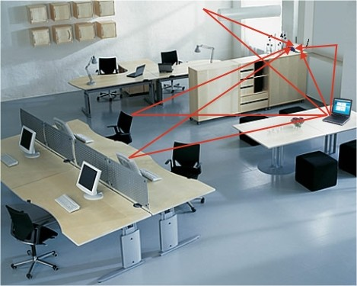





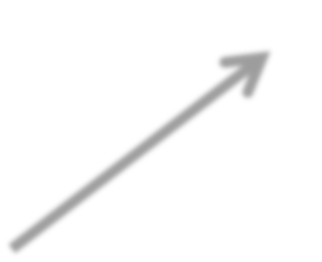







The challenge: multipath reflections
Problem #1: Strong multipath reflections indoors
Problem #2: Direct path attenuated or completely blocked
– Direct path signal may not be the strongest
Wall
AoA spectrum
Array
Client
AP
0.2
0.4
0.6
Furniture
0.8
1

Slide 10

ArrayTrack’s multipath suppression algorithm
Key observation: direct path bearing is more stable than reflection path bearings when client moves slightly
array
AP
Client

Slide 11

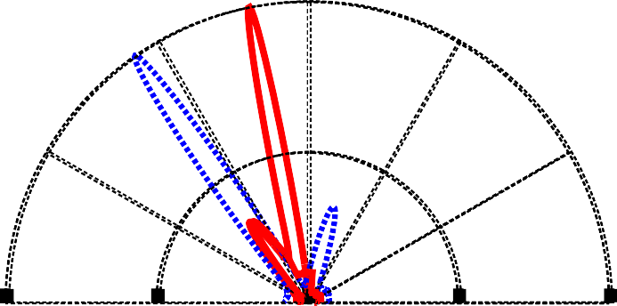



ArrayTrack’s multipath suppression algorithm
Given: AoA spectra from two nearby locations
Find the peak bearings in each AoA spectrum
Discard any peak not paired with a peak in the other AoA spectrum
✔
Two peak bearings within five degrees are considered paired

Slide 12
Step 1: detection and recording
Content of packet and modulation type do not matter
Works with any part of a packet
– ArrayTrack utilizes the most robust preamble part
800 ns
3.2 µs
3.2 µs
G
10 short training symbols two long trainning symbols
Preamble
12

Slide 13
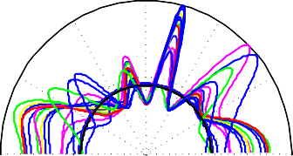
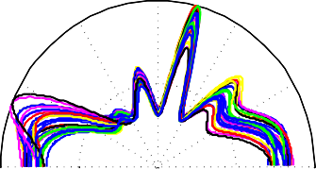
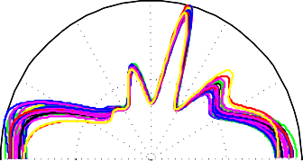
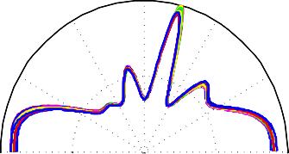
Step 1: detection and recording
Very small part of a packet needed
N =1
N =5
1 90
190
60 120 60
120
30
0.5
150 30
180 0
0.5
150
– For a 40 MHz sampling rate, one sample is 25 ns
0
180
In the absence of noise, one sample works
Employ multiple samples for
30
averaging to remove noise
0
N =10
1 90
N =100
190
300
240
60
120
60
120
0.5
150
30
0.5
150
180 0
180
 |  |  | Packet body
Preamble part

Slide 14

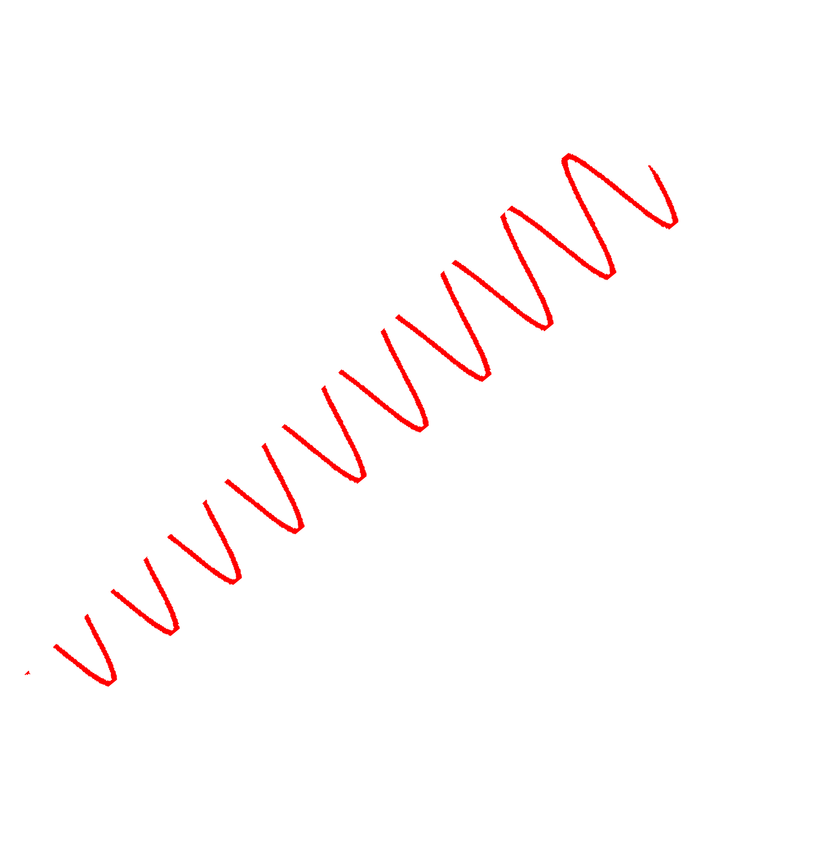

Step 1: detection and recording
Diversity synthesis: existing 802.11 radios record the 1st half of the preamble from antenna 1 and the 2nd half from antenna 2
ArrayTrack’s diversity synthesis algorithm
  Record 10 samples from the first preamble half and another 10 samples from the second preamble half with different antennas
  Double the number of antennas we can utilize for ArrayTrack
antenna 1
antenna 2
Port 1
Radio
Port 2
 | 1 |  | 2 | Packet body
Preamble part

Slide 15
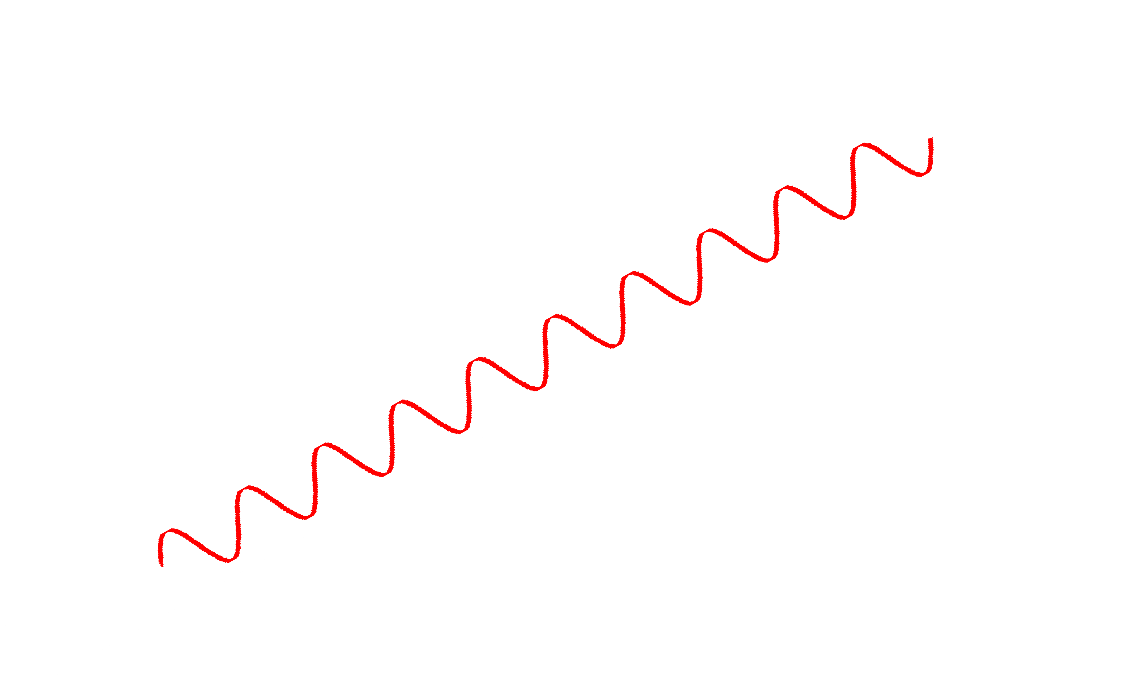
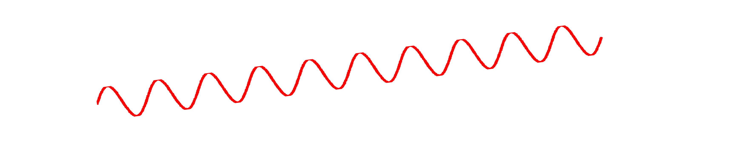
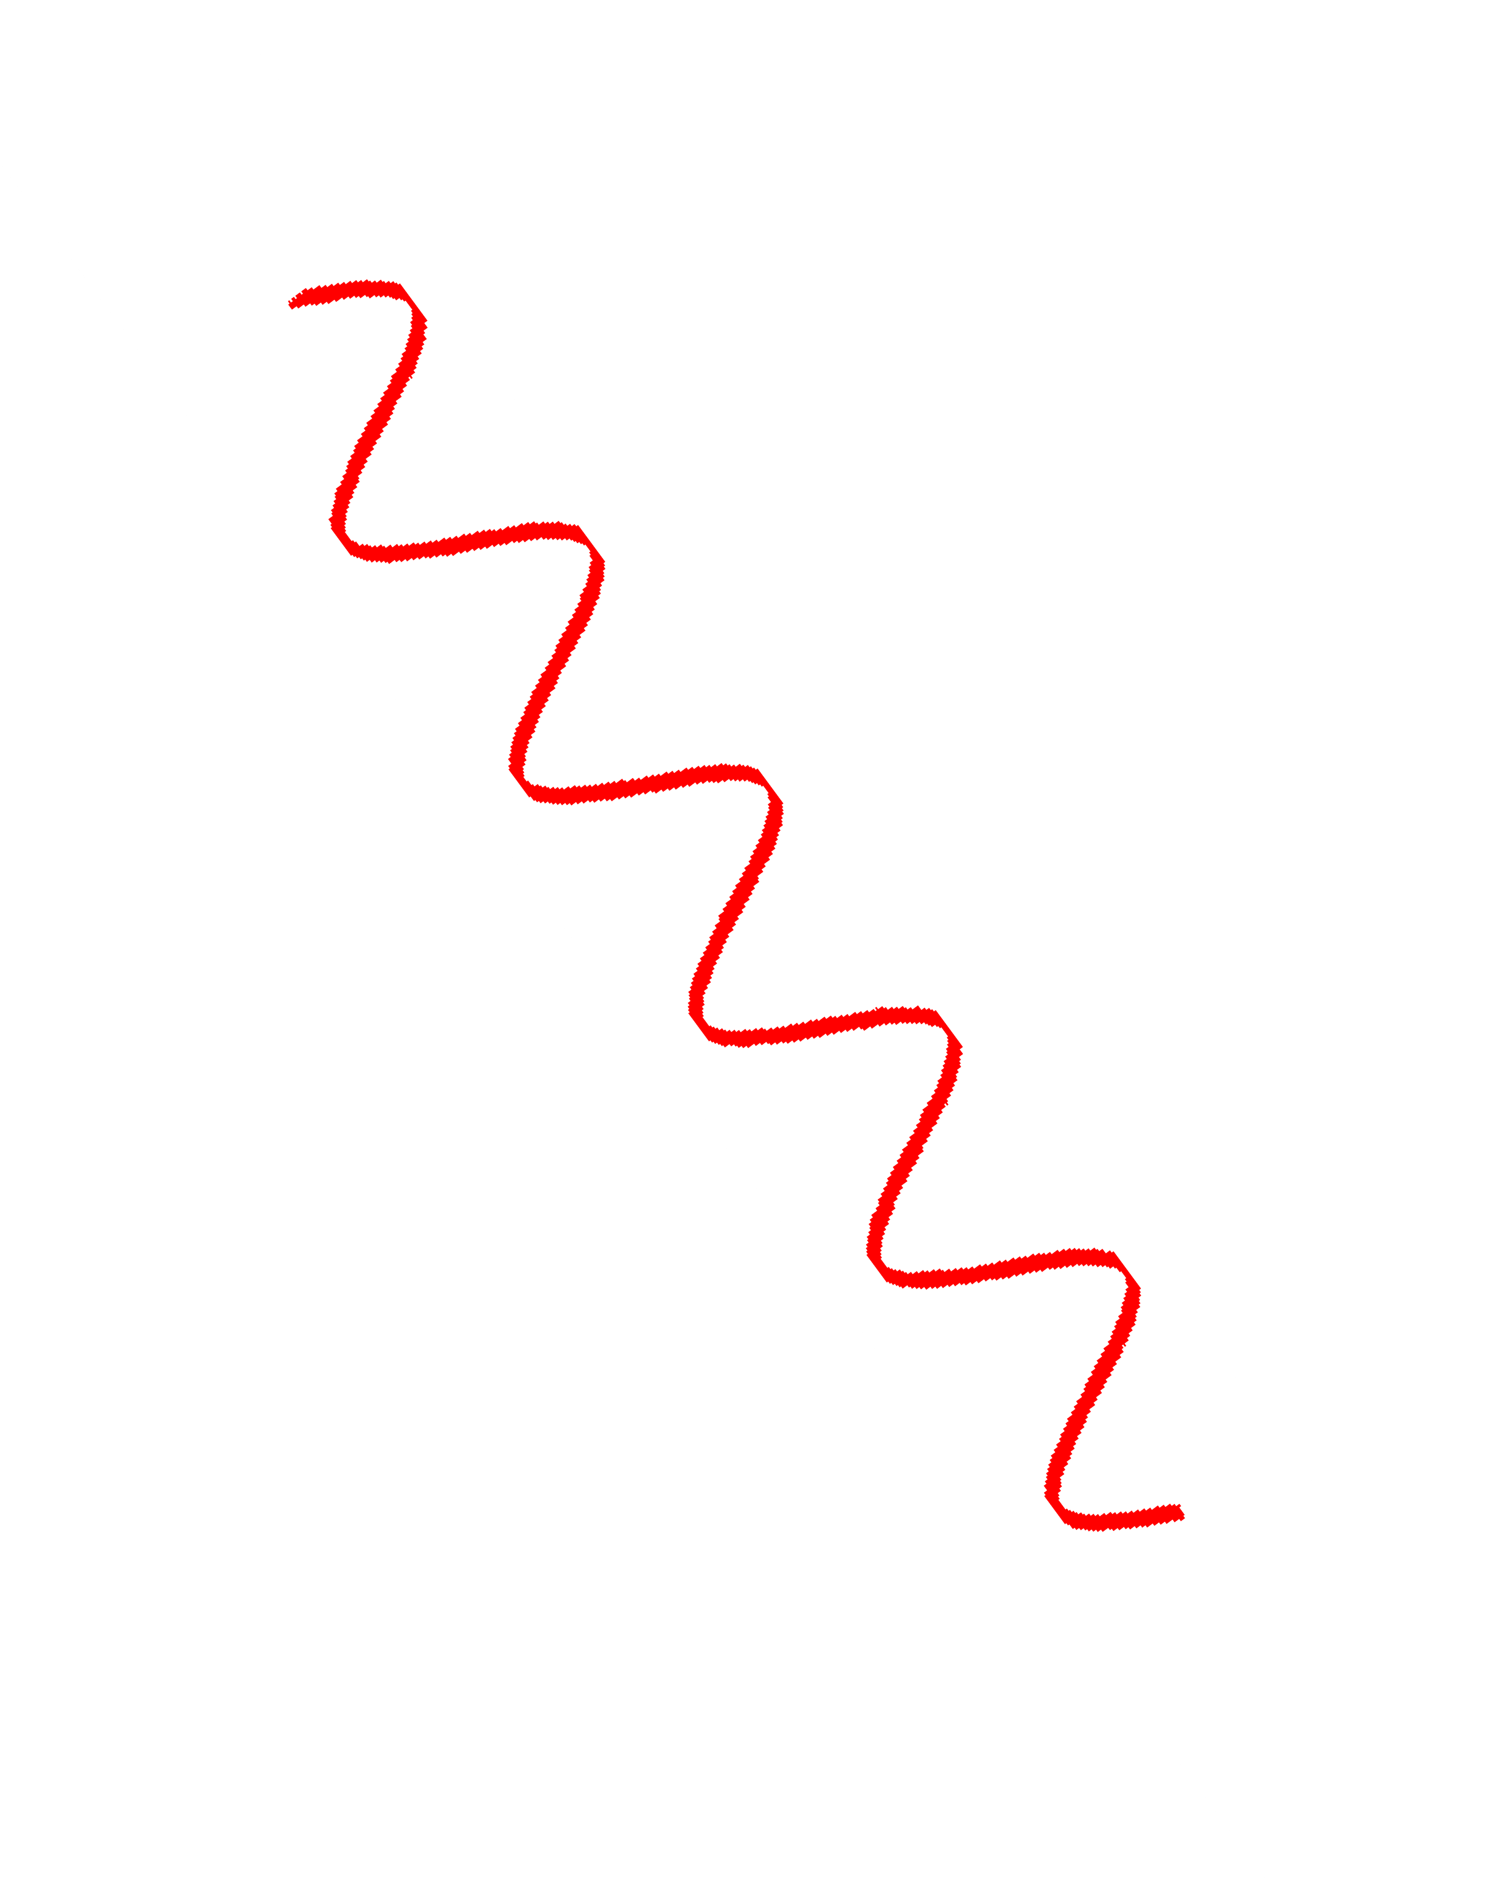










Step 2: AoA spectrum generation
MUSIC algorithm [Schmidt, 1986] for AoA spectrum estimation
– Does not work well for indoor environment because of coherent signals:
Transmitter
Receiver (Client)
(AP)
Spatial smoothing (SS) [Shan et al, 1985] handles coherent signals
NO spatial smoothing (SS)
SS with 2 sub−array groups
60
90
120
60
90
1 120
1
30
0.5
150
30
0.5
150
x₁ x₂ x₃ x₄ x₅ x₆ x₇ x₈
0
180
0
180

Slide 16
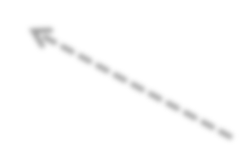
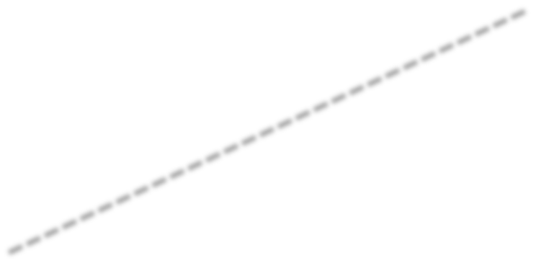


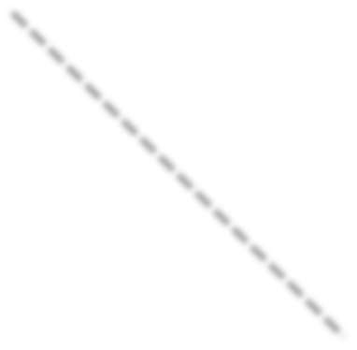
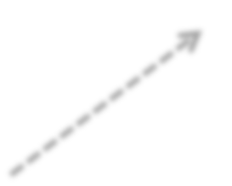

Step 3: AoA spectra synthesis
N APs generate N AoA spectra
P(x₁) =0.45
AP 1
For a random position X, the likelihood of being at X is a multiplication of
probabilities from multiple APs
P(x) = P(x₁) * P(x₂)
0.2
0.4
0.6
X
0.8
P(x₂) =0.6
1
1
0.8
0.6
0.4
0.2
AP 2
16

Slide 17

Step 4: search for highest probability position

Slide 18
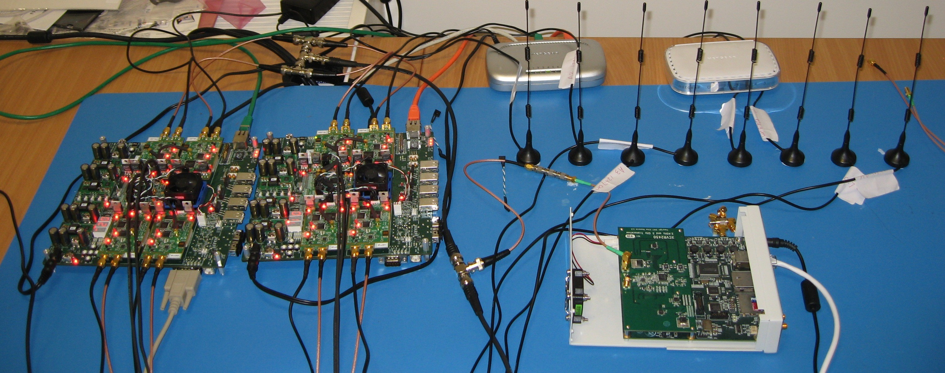
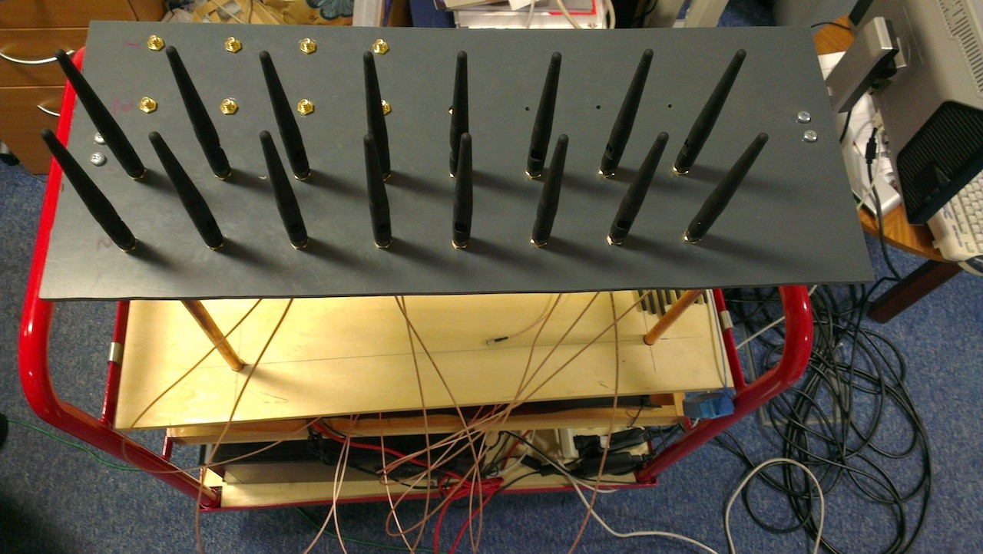
Implementation
AP: two WARPs, each with four radio boards (eight antennas)
  Custom FPGA design using Xilinx System Generator for packet synchronization, diversity synthesis, RF oscillator synchronization
  4-16 antennas placed in a linear arrangement, spaced at λ/2 (6.13 cm)
Clients: Soekris boxes equipped with 802.11 radios
Backend location server: implemented in Matlab (1,000+ LoC)

Slide 19
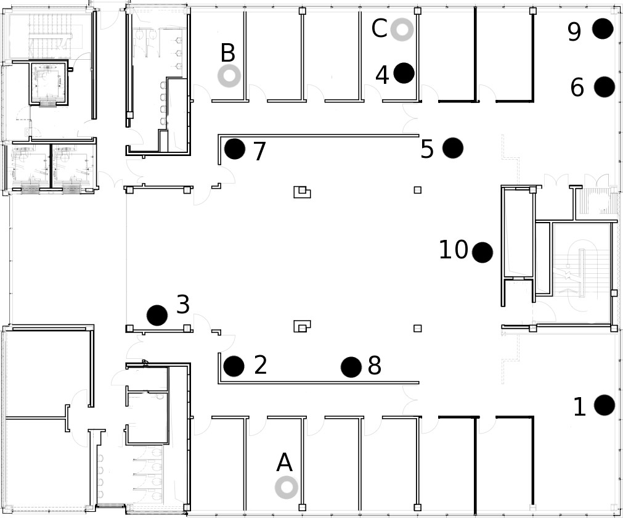




Floorplan: client and AP positions
Backend server has knowledge of each AP’s location
6
N
AP
1
4
Client
3
2
5

Slide 20
Evaluation
How accurate is MUSIC + SS?
ArrayTrack’s multipath suppression improvement
Effect of number of antennas on each AP
Effect of client-AP differences in height

Slide 21
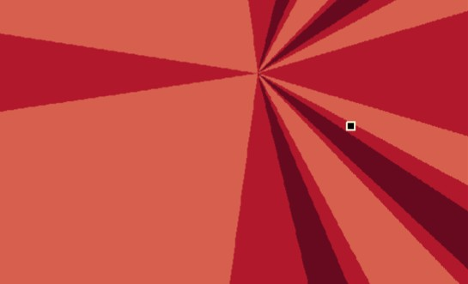
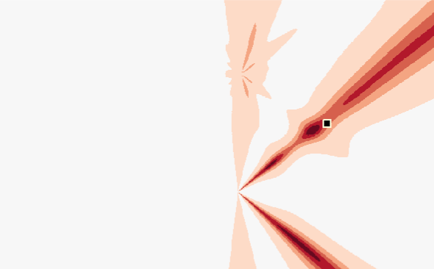
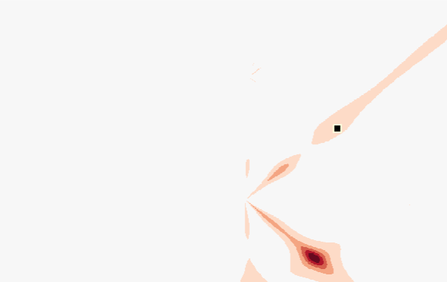
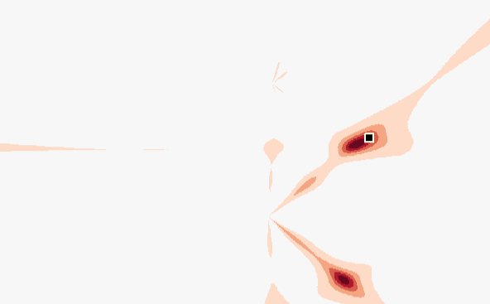
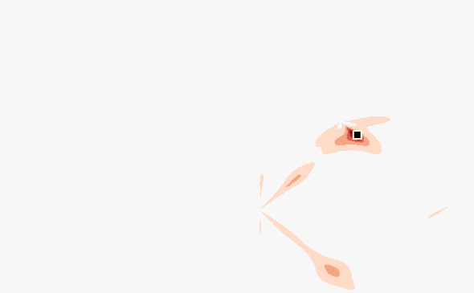

Effects of number of APs
Heatmap example of increasing number of APs
two APs
one AP three APs
four APs
five APs
six APs

Slide 22
MUSIC + SS achieves 26 cm accuracy
In general, with increasing number of APs, more accurate location information can be obtained
1
6 APs (MUSIC + SS)
5 APs (MUSIC + SS)
4 APs (MUSIC + SS)
3 APs (MUSIC + SS)
0.9
0.8
0.7
0.6
0.5
0.4
0.3
0.2
0.1
CDF
0
1
5 10 20 50 100
Location error (cm)
50010002500
22

Slide 23
Evaluation
How accurate is MUSIC + SS?
ArrayTrack’s multipath suppression improvement
Effect of number of antennas on each AP
Effect of client-AP differences in height

Slide 24
Multipath suppression improves accuracy
Median: 23 cm (ArrayTrack with 6 APs)
1
0.5
ArrayTrack (6 APs) MUSIC + SS (6 APs)
0
0
500
1000
1500 2000 2500
1
With multipath suppression, the long tail is removed
0.5
ArrayTrack (5 APs) MUSIC + SS (5 APs)
1500 2000 2500
0
0
500
1000
1
CDF
0.5
ArrayTrack (4 APs) MUSIC + SS (4 APs)
0
0
500
1000
1500 2000 2500
The fewer APs, the more important is multipath suppression
1
0.5
ArrayTrack (3 APs) MUSIC + SS (3 APs)
0
0
500
1000 1500 2000 2500
Location error (cm)

Slide 25


Optimal subset of APs
On average, 6 APs present the best result
It’s not true for a particular position
1
0.9
0.8
0.7
2.5 cm
23 cm
0.6
CDF
0.5
0.4
0.3
0.2
ArrayTrack (6 APs) Optimal subsets of APs MUSIC + SS (6 APs) MUSIC + SS (3 APs)
0.1
0
1
5 10 20 50 100 500
Location error (cm)
2500
25

Slide 26
Evaluation
Effect of number of APs on accuracy
Multipath suppression improvement
Effect of number of antennas on each AP
Effect of client-AP differences in height/orientation
26

Slide 27
Number of antennas at AP
1
ArrayTrack 4−antenna APs ArrayTrack 6−antenna APs
0.9
ArrayTrack 8−antenna APs
0.8
0.7
0.6
0.5
0.4
0.3
0.2
0.1
CDF
0
10 20 50 100
Location error (cm)
1
500
27

Slide 28
Evaluation
Effect of number of APs on accuracy
Multipath suppression improvement
Effect of number of antennas on each AP
Effect of client-AP differences in height

Slide 29
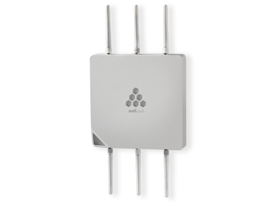



High accuracy despite AP-client height difference
1
Different antenna heights
ceiling
Original
0.8
3 m
1.5 m
CDF
0.6
0.4
0.2
0
1
10 20
Location error (cm)
100

Slide 30


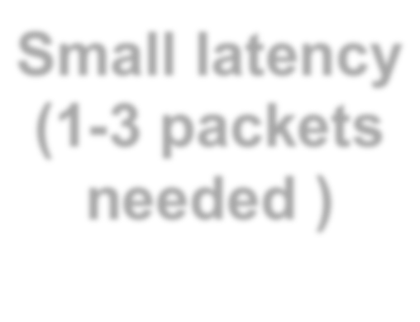


Other characteristics of ArrayTrack
Small latency (1-3 packets needed )
Robust against low SNR
Robust against collision

Slide 31
Conclusions
ArrayTrack: a robust, fast and responsive localization system with a median accuracy level of 23 cm (6 APs) and one meter (3 APs)
  Novel multipath suppression and diversity synthesis algorithms
  Uses only the WiFi infrastructure nearby
  Robust against low SNR and packet collisions
  Fast and responsive: requires only 1-3 packets
Three dimensional tracking with two-dimensional array for future work
Thank you!

Slide 32
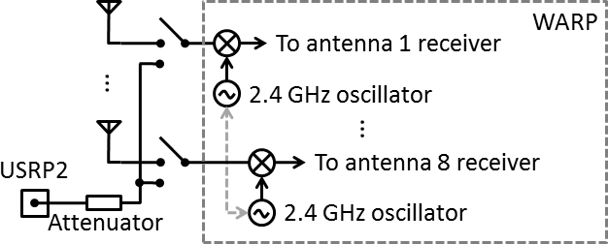
Implementation challenges
Wire connects WARPs to share the same sampling clock and RF oscillator
USRP2 calibrates WARPs to remove WARP internal phase offsets
Remove phase offsets due to hardware imperfections
  Cables labeled with the same lengths are not exactly the same
  SMA splitters are not fully balanced

Slide 33
AP-client antenna orientations
Circularly-polarized antennas mitigate the performance drop
Different antenna orientations
1
Different antenna heights
Original
0.8
CDF
0.6
0.4
0.2
0
10 20
Location error (cm)
1
100
33

